Slide 1
Autosave Lab
John Sinclair,
Kay Kasemir
July 2026

Slide 2
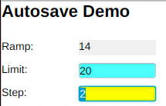
Run IOC without autosave
  Build and run IOC
    cd /ics/examples/06_autosave
    make
    cd iocBoot/iocdemo
    ./st.cmd
  In another window
    In css, open 06_autosave/opi/autosave.bob
    Change the “limit” and “step”
  Stop the IOC, start it again
    Did “limit” and “step” retain what you entered?

Slide 3
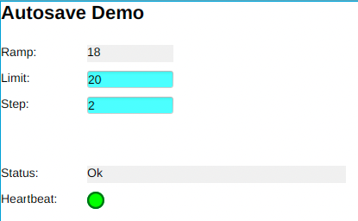
Configure IOC with autosave
  Update IOC config and run IOC
    Note the “Autosave” section in here:
    gedit /ics/examples/06_autosave/demoApp/src/Makefile
    ➔ autosave support was already included but not configured.
    Adjust the IOC startup file, note commented sections related to autosave, save/restore.
    Save edited st.cmd, then run IOC
    cd /ics/examples/06_autosave/iocBoot/iocdemo
    gedit st.cmd
    ./st.cmd
    When you now adjust “limit” and “step”,
    wait 5 seconds,
    stop and restart the IOC.
    Does it retain what you entered?
    Check the *.db file that you load for “info…” tags.
    Check the generated *.req, *.sav files

